Slide 1
Project Overview
Project Name – Travel with Safari
Project Type – Web Application
Language – Python, Javascript, HTML, CSS
Framework – Django, Bootstrap
Database – PostgreSQL

Slide 2
Project Objective
To provide hassel free travelling experience for the users to explore, enjoy and enhance the desire of completing the bucket list of their dreams.
Our handpicked curated section of "Recommended Places" by our team is eye-catching, loved and travelled by many. They can share their happiness and help others by posting relevant informations through our community section.
Through this website our goal is to promote local arts, travelling agencies, hotels, translators, to expand their business and help to build national economy through tourism.

Slide 3
PART #1 – Homepage

Slide 4
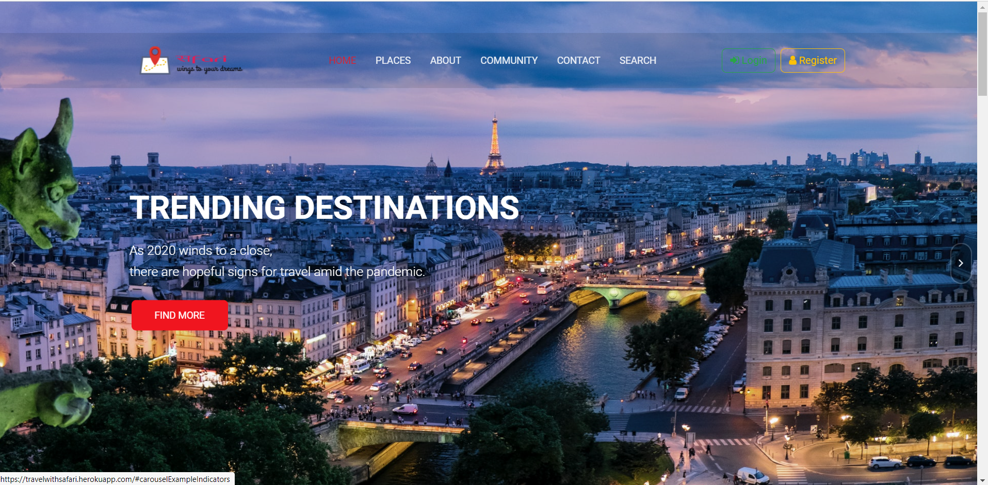
Homepage Content
Navigation Bar
Login/Register
Trending Locations & Our Recommendations

Slide 5
Homepage – Navigation Bar
Section : Home, Places, About, Community, Contact, Search, Login, Register
Used for navigating throughout the web appliaction.
Highlighted Technology : Bootsrap, JavaScript
Dynamic Nav Bar based on frames per second.

Slide 6
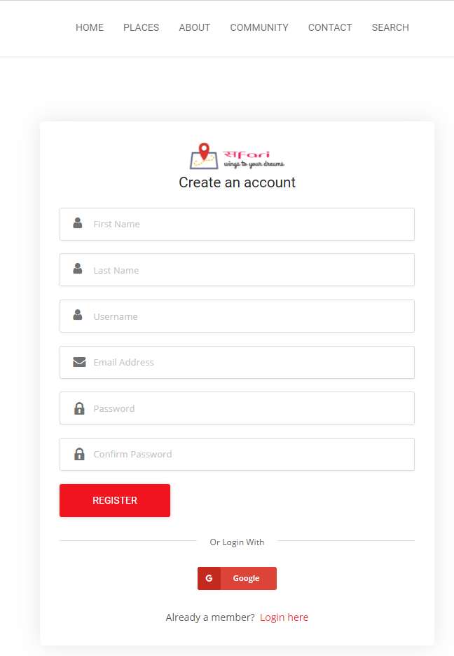
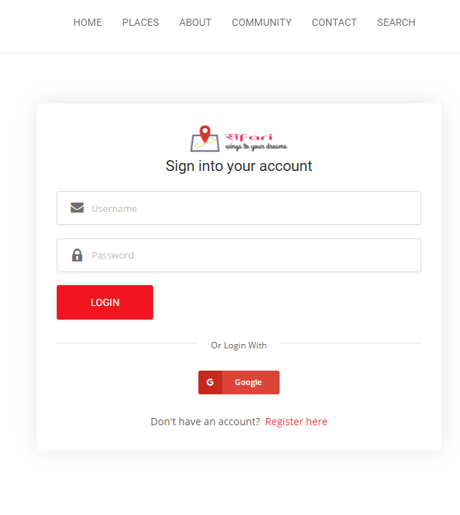
Homepage – Login/Register
Third Party Login/Register - Google.
Login and Register is done by DjangoAllAuth package.
Security and privacy of user password is taken care by SHA256 algorithm.
Highlighted Technology : DjangoAllAuth, Google Developer Console, PostgreSQL, HTML Form.

Slide 7
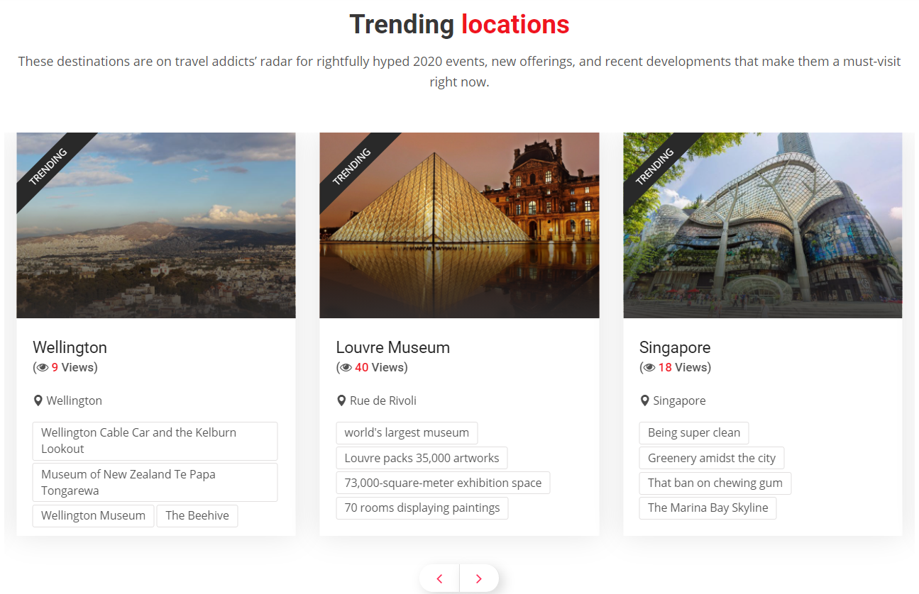
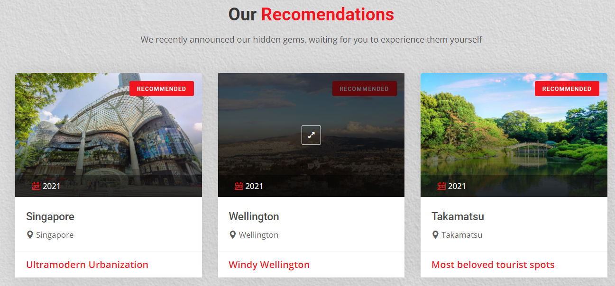
Homepage – Trending Locations & Our Recommendations
"Trending Locations" has the most visited places of the web application based on views.
"Our Recommendations" has the recommended places by the Admin of the web application.
Highlighted Technology : Bootstrap Cards, PostgreSQL

Slide 8
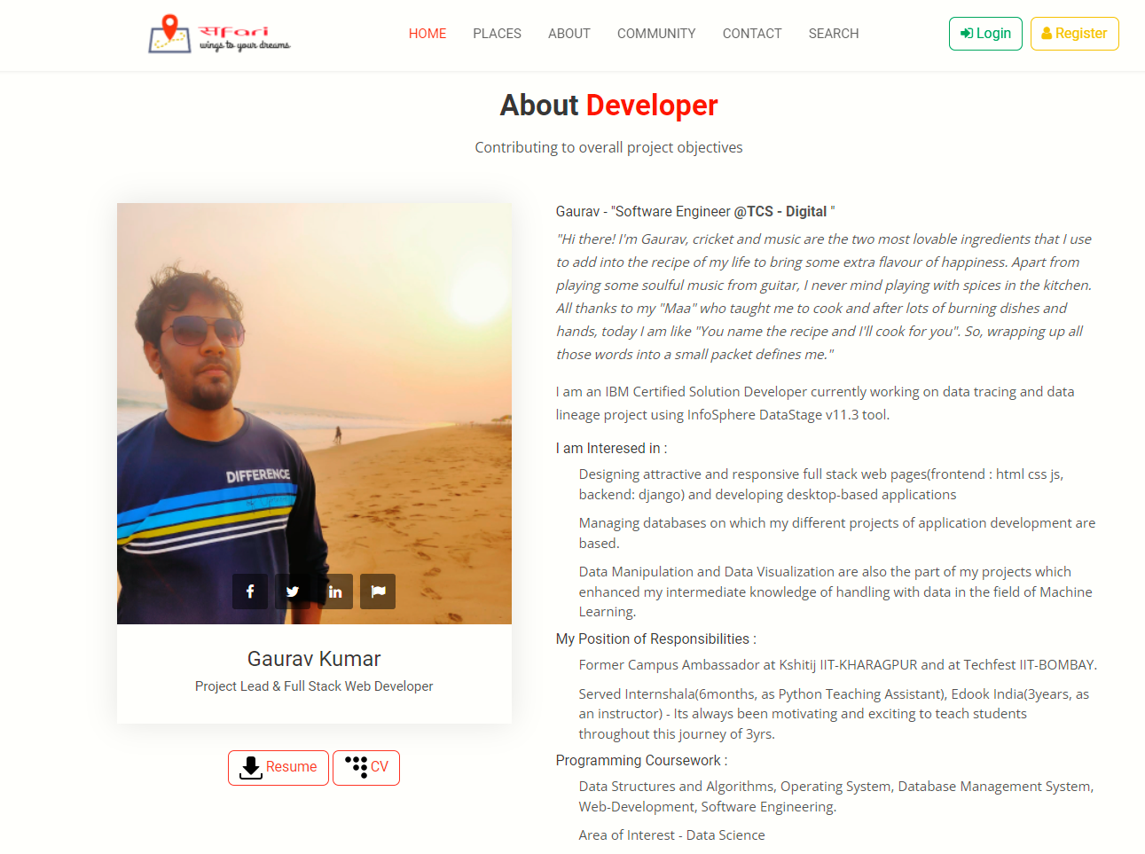
Homepage – About Developer Section
About the developer – Contributing to the overall objective of the project.
Resume and CV.
Social media handles

Slide 9
PART #2 – Places & Search

Slide 10
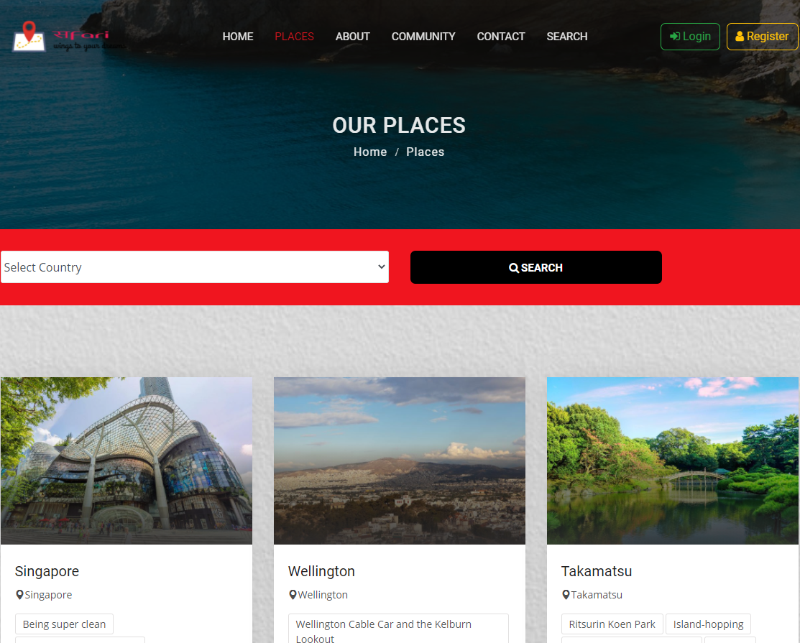
Places & Search Content
Pagination of Places
Place Details
Search Places
Database Overview

Slide 11
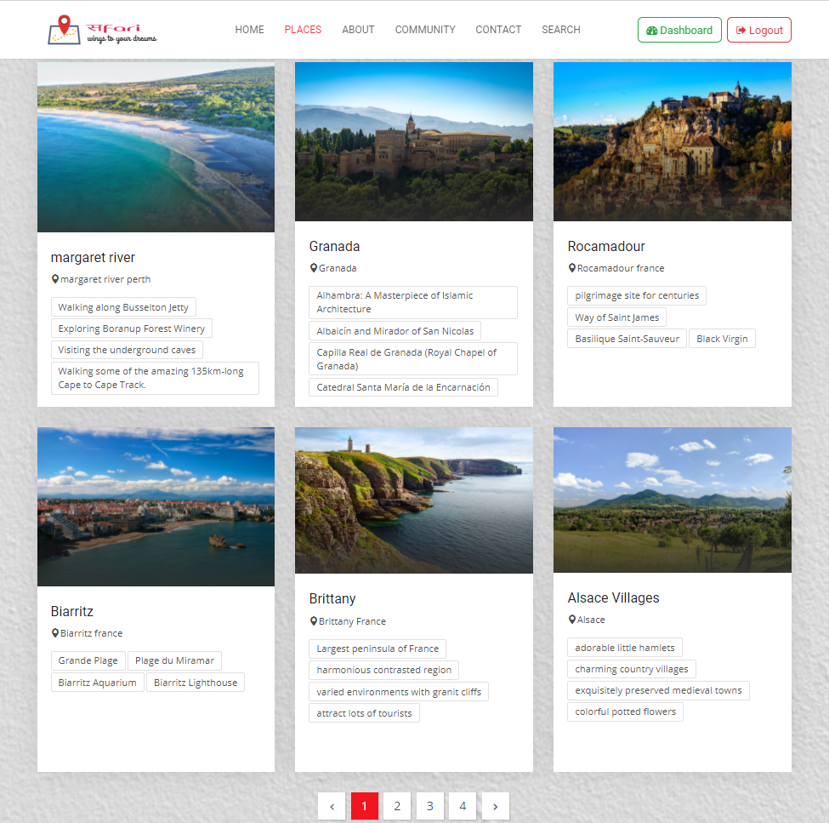
Places & Search – Pagination of Places
"Places" contains the grid view of different places added by the admins.
Highlighted Technology : Django Pagination, Bootstrap Cards, JavaScript Preview Window, Pillow, PostgresSQL.
Section : Place Images, Image Preview, Place Title, Place Location (Google Maps), Top 4 Place Features

Slide 12
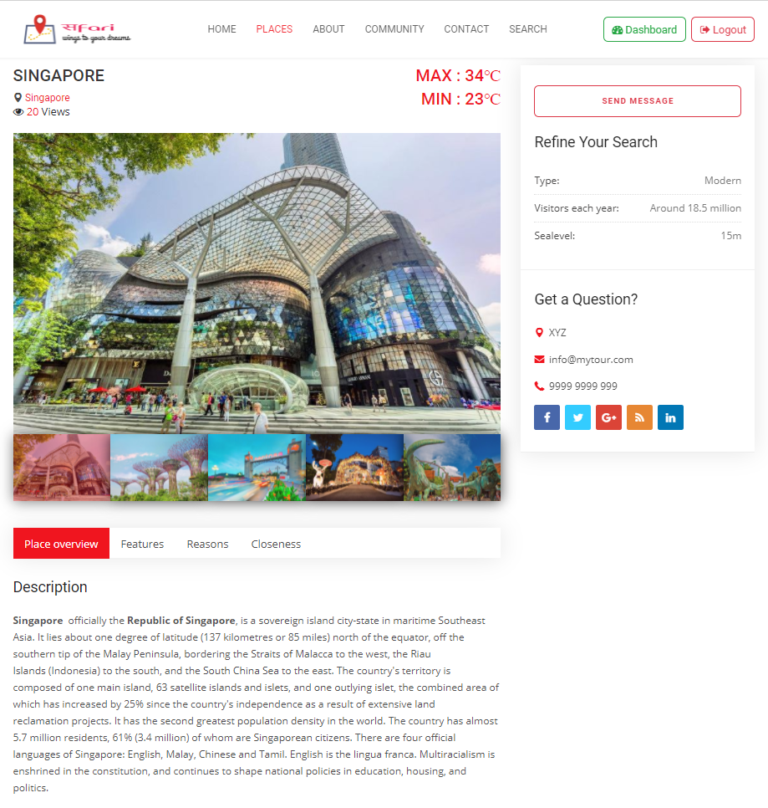
Places & Search – Place Details
"Places Details" contains the information about the places in full details.
Highlighted Technology : Bootstrap Carousel, SMTPLib, HTML Form, PostgreSQL, Dj-Database-Url.
Section : Place Images, Place Title, Place Location (Google Maps), Views, Temperature, Height from Sea Level, Type, No. Of Visitors, Description, Features, Reasons to Visit, How to Reach.
It also has a "Send Message" section to ask any query about the place from the admin via email.
Every Query by the user can be seen in user's "Dashboard".

Slide 13
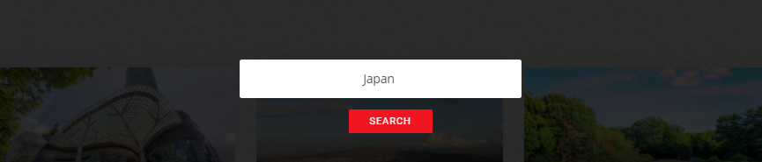
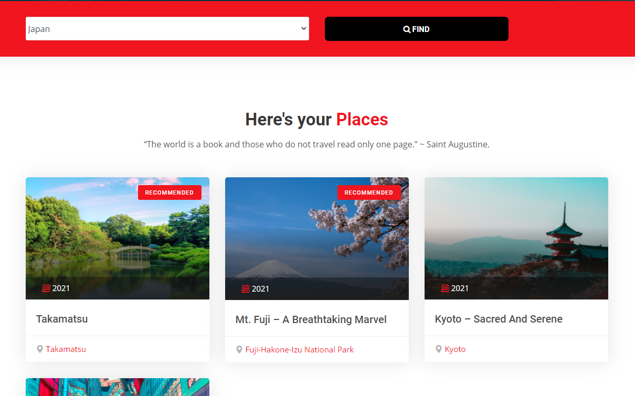
Places & Search – Seach Places
Highlighted Technology : Bootstrap Cards, Python, PostgresSQL.
"Search Places" helps user to search different places based on their location.

Slide 14
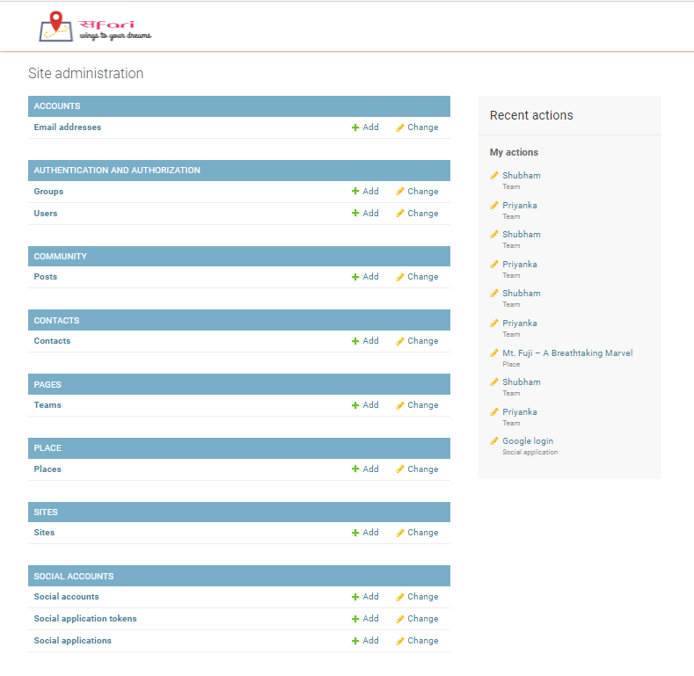
Database Overview

Slide 15
PART #3 – Community

Slide 16
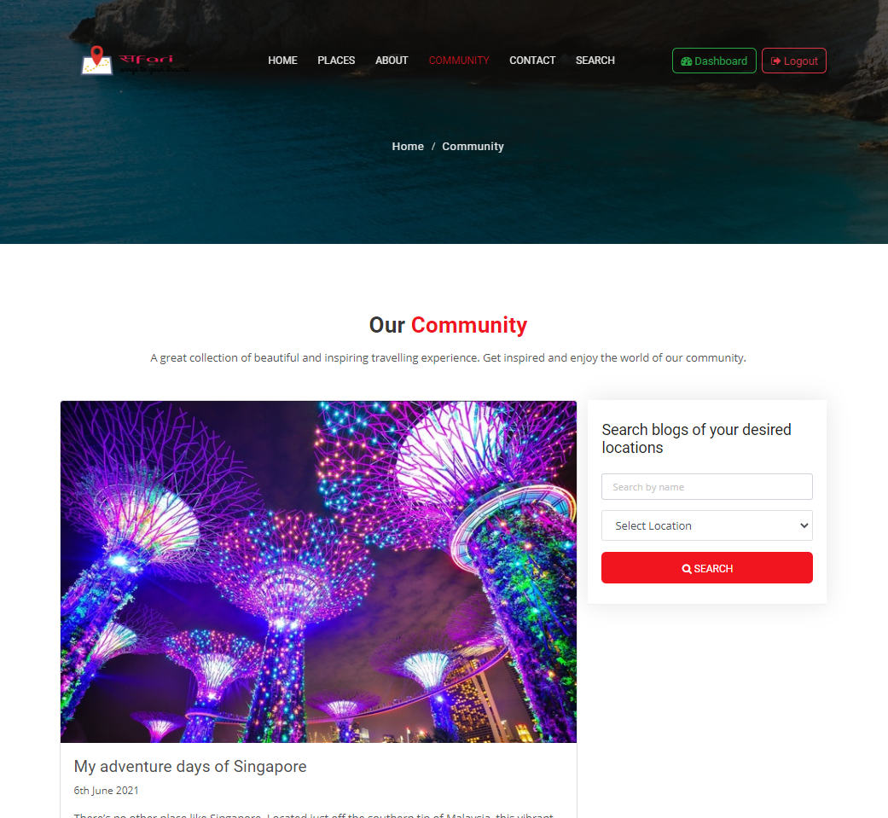
Community Content
Main Page
Add Post from Dashboard
Database Overview
Post Details

Slide 17
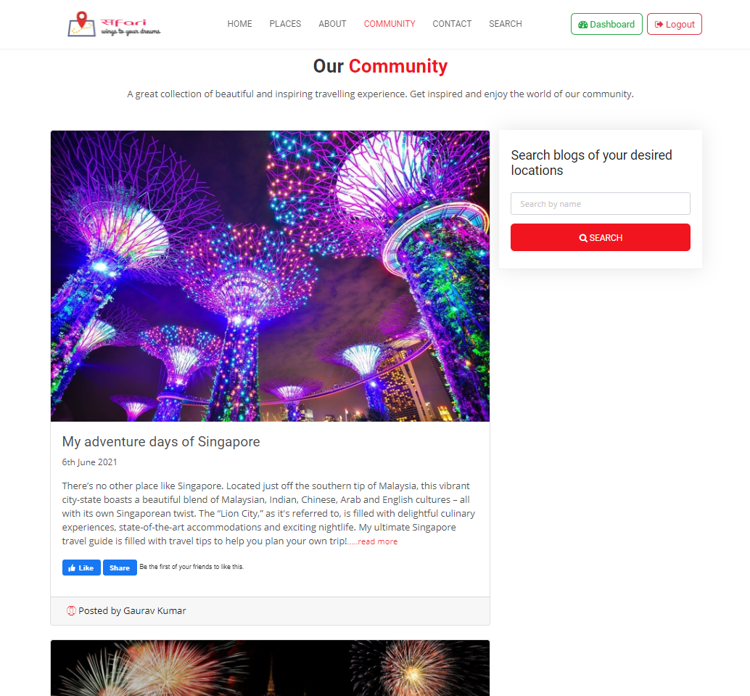
Community – Main Page
Main Page of the Community section contains different posts from the users.
Highlighted Technology : HTML, CSS, JavaScript, Python, PostgresSQL.
Section : Search, Post Title, Post Date, Post Content, Like, Share.
Search facility is useful for searching posts based on keywords.

Slide 18
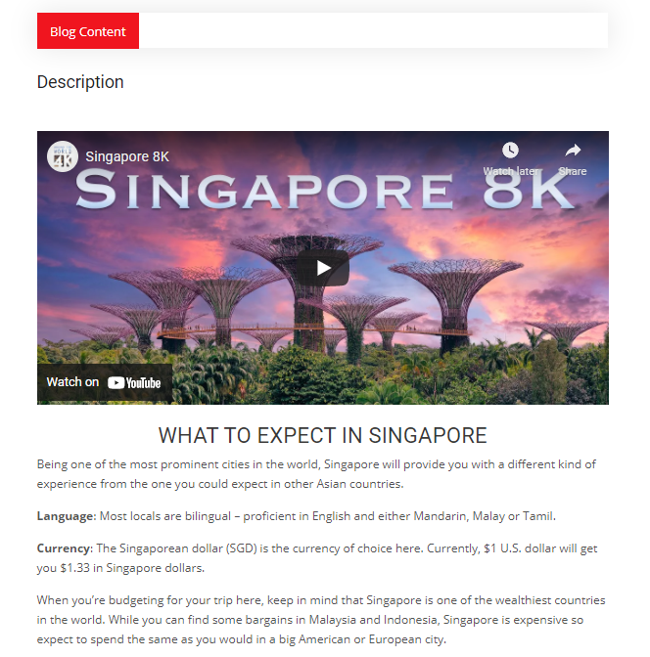
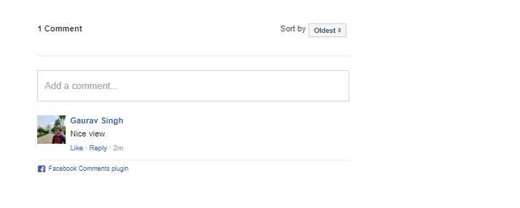
Community – Post Details
Upon Clicking on a post, user can view the entire blog content of the post.
Highlighted Technology : Facebook Like Comment Integration, PostgresSQL.
The blog mays contains Styled text, YouTube Video, Images, etc.
It also has a comment section to interact with the blogger.

Slide 19
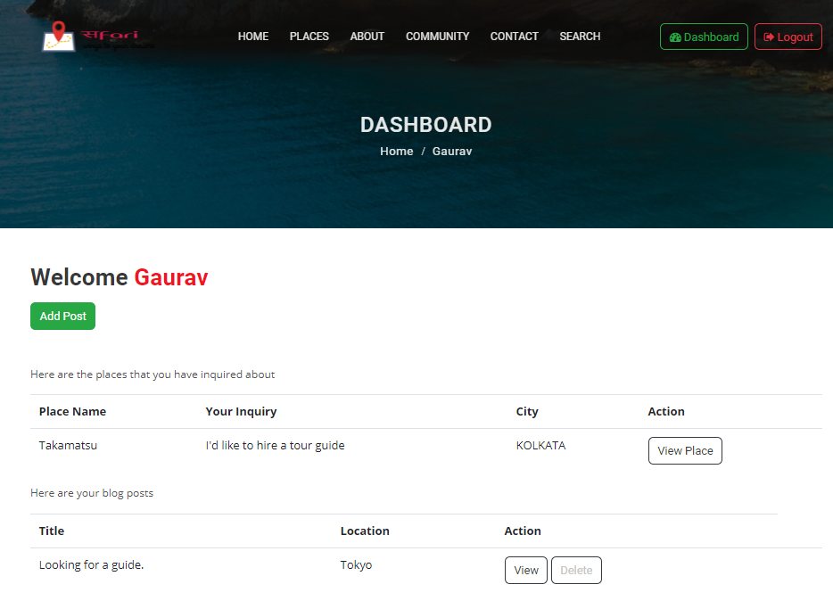
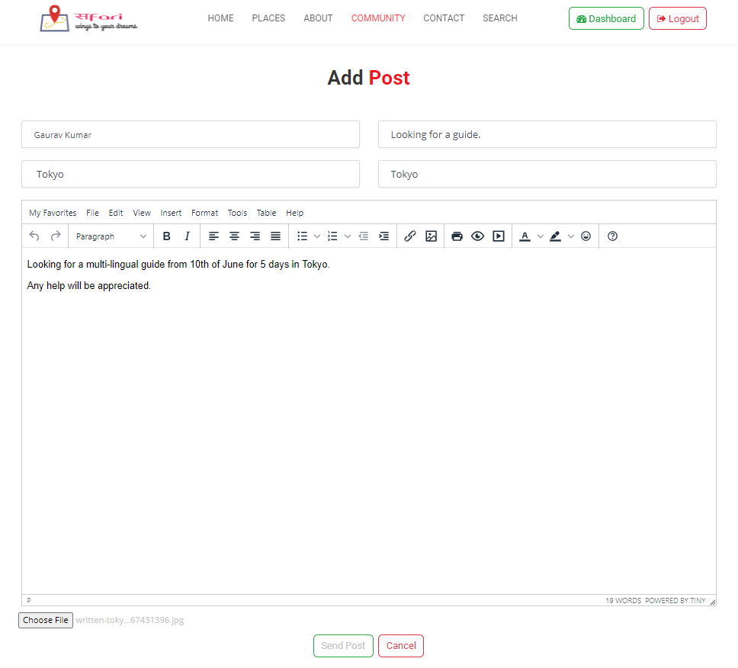
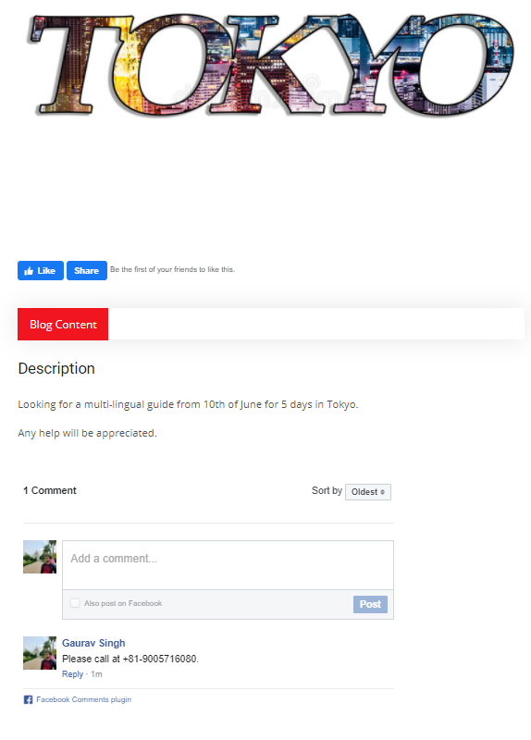
Community – Add Post from Dashboard
Upon Clicking on a "Add Post", from "Dashboard", user can add post to the community section
Highlighted Technology : CK-Editor, HTML Form, HTML Table, Python, PostgreSQL.
The post editor can incorporate any type of image, links, YouTube Video, formatted text, etc.

Slide 20
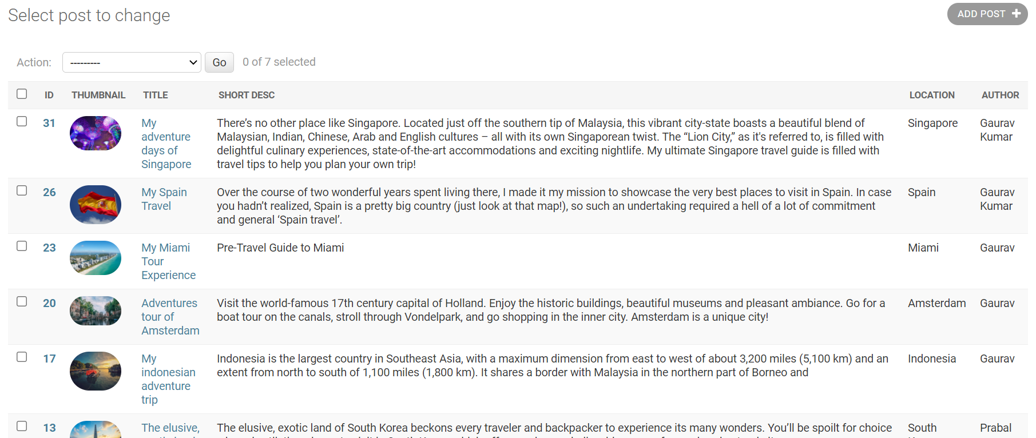
Community – Database Overview

Slide 21
PART #4 – About & Contact

Slide 22
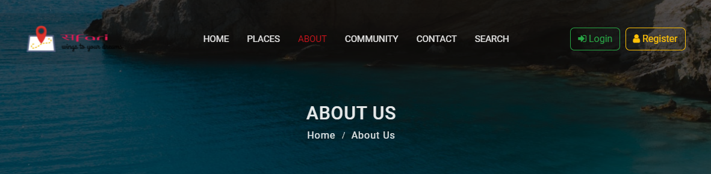
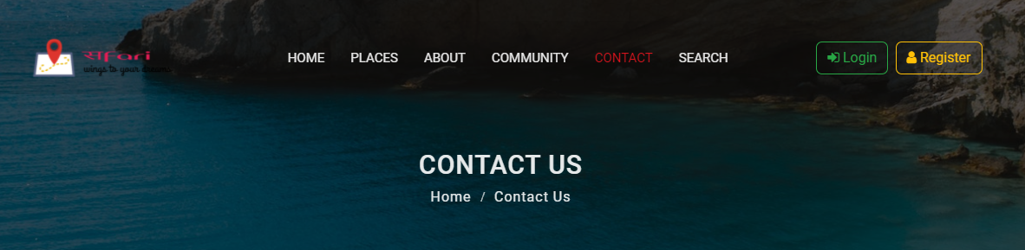
About & Contact Content
About Us
Contact Us

Slide 23
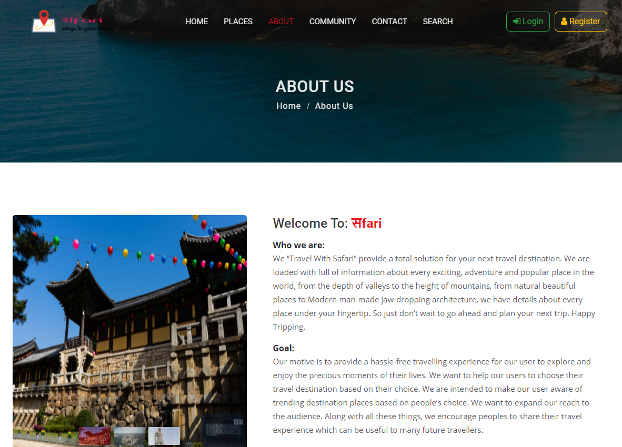
About & Contact – About Us
"About Us" has the brief information about the web application and its purpose.
Highlighted Technology : Unsplash API, Bootstrap Carousel, HTML, CSS
Section : Who we are?, Goals, Values, Mission, Executive Teams

Slide 24
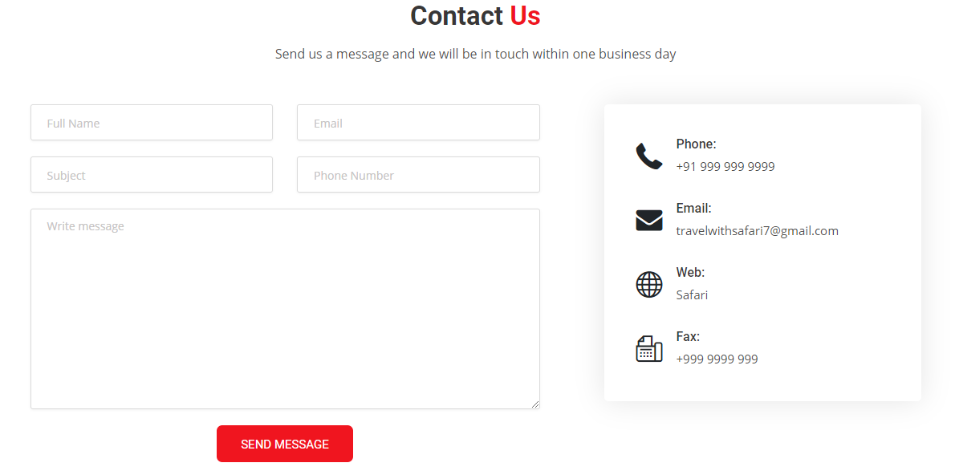
About & Contact – Contact Us
To contact the admins of website about any query related to places, businesses, etc., via e-mail.
Highlighted Technology : SMTPLib module for email, Bootstrap Cards, HTML Form, Django Messaging Framework.

Slide 25
Future Scopes
Enable other 3rd-party login such as Facebook, Instagram, etc.
Local Business section for services such as small restaurants, lodging facilities, hiring guides and vehicles, etc.
Local Market section for famous products of the tourist place via Ads and Posts.

Slide 26
References
[1] Link to Web App : https://travelwithsafari.herokuapp.com
[2] Beautiful Free Images & Pictures | Unsplash
[3] Free Stock Photos · Pexels

Slide 27
Thank you!

